Slide 1
Cybersecurity
BGP hijacking
DDoS
Botnets
What’s next?

Slide 2
BGP hijacking
The illegitimate takeover of IP addresses by corrupting BGP
April 1997: The "AS 7007 incident”
December 24, 2004: TTNet in Turkey hijacks the Internet
May 7, 2005: Google's May 2005 Outage
January 22, 2006: Con-Edison hijacks big chunk of the Internet
February 24, 2008: Pakistan's attempt to block YouTube takes down YouTube entirely
November 11, 2008: Brazilian ISP leaked their internal table into the global BGP table
April 8, 2010: China Telecom originated 37,000 prefixes not belonging to them in 15 min
February, 2014: a hacker redirected traffic targeting crypto-currency mining operations
January 2017: Iranian pornography censorship

Slide 3
BGP hijacking
The illegitimate takeover of IP addresses by corrupting BGP
Kind of complicated
More “state’s” than hacker’s attacks
Mitigation measures – but hard to get rid of
Old story – no big news here

Slide 4
DDoS
a cyber-attack where the perpetrator seeks to make a resource unavailable by disrupting services of a host connected to the Internet.
Volume of attacks increased by 10x

Slide 5
DDoS
a cyber-attack where the perpetrator seeks to make a resource unavailable by disrupting services of a host connected to the Internet.
Volume of attacks increased by 10x
Often connected with botnet

Slide 6
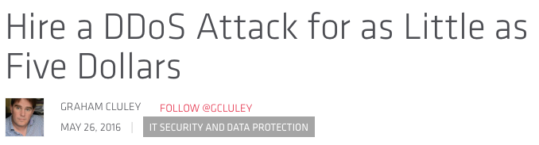
DDoS
a cyber-attack where the perpetrator seeks to make a resource unavailable by disrupting services of a host connected to the Internet.
Volume of attacks increased by 10x
Often connected with botnet
Buy-as-you-go style

Slide 7
DDoS
a cyber-attack where the perpetrator seeks to make a resource unavailable by disrupting services of a host connected to the Internet.
Volume of attacks increased by 10x
Often connected with botnet
Buy-as-you-go style
Sometimes unwanted errors (Apple DNS bug)

Slide 8
BOTNET
a cyber-attack where the perpetrator seeks to make a resource unavailable by disrupting services of a host connected to the Internet.
Volume of attacks increased by 10x
Often connected with botnet
Buy-as-you-go style
Sometimes unwanted errors (Apple DNS bug)

Slide 9
Where we are
FTTx: From 20Mbps/1Mbps to 1Gbps/100Mbps
IOT: From 1PC to tens of devices @ home
Smartphones: CPU more powerful than your laptop
Mobility: 5G anyone?

Slide 10

Where we are
FTTx: From 20Mbps/1Mbps to 1Gbps/100Mbps
IOT: From 1PC to tens of devices @ home
Smartphones: CPU more powerful than your laptop
Mobility: 5G anyone?
Encryption: more than 50% of web traffic is over HTTPS
SAFER

Slide 11
Where we are
The future
FTTx: From 20Mbps/1Mbps to 1Gbps/100Mbps
IOT: From 1PC to tens of devices
Smartphone: CPU more powerful than your laptop
Mobility: 5G anyone?
Encryption: more than 50% of web traffic is over HTTPS
Safer: It makes in-network protection (totally) useless

Slide 12
Next Challenge
Your (company) privacy

Slide 13
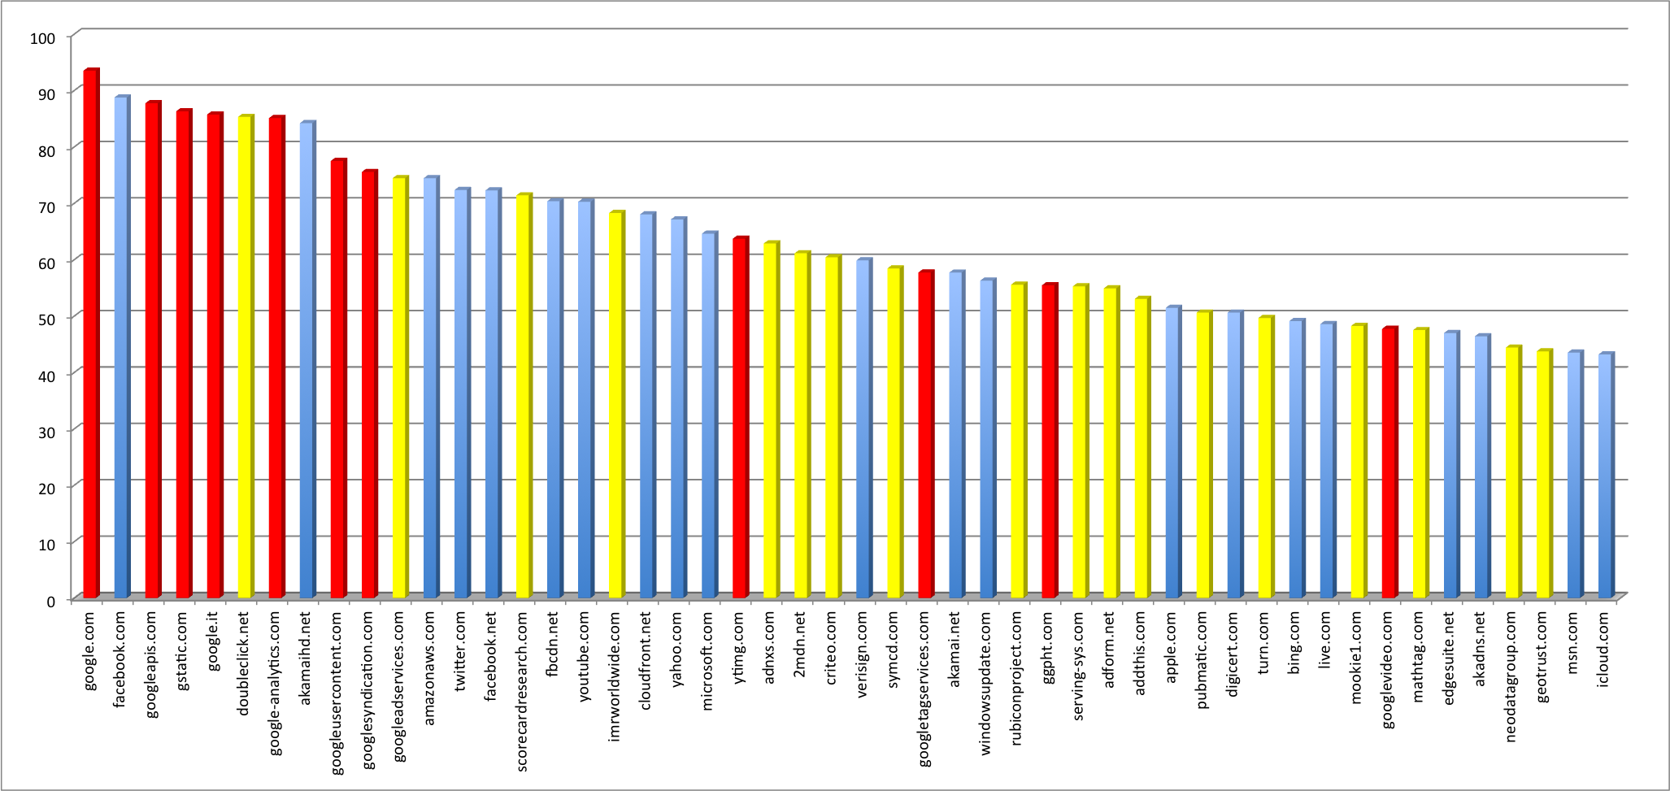

Google
Third-party service
Welcome
ScorecardResearch, […] a leading global market research effort that studies
and reports on Internet trends and behavior.
ScorecardResearch conducts research by collecting Internet web browsing data
and then uses that data to help show how people use the Internet,
what they like about it, and what they don’t.
ScorecardResearch collects data through […] web tagging.

Slide 14
If you’re not paying for the product,then you are the product…”
– Phil Zimmerman, Creator, PGP

Slide 15

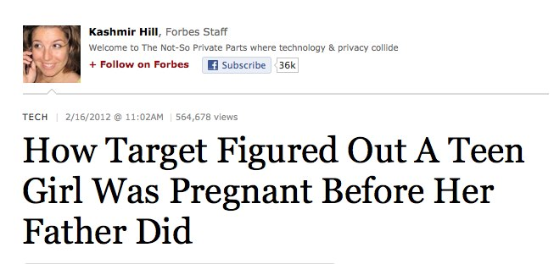
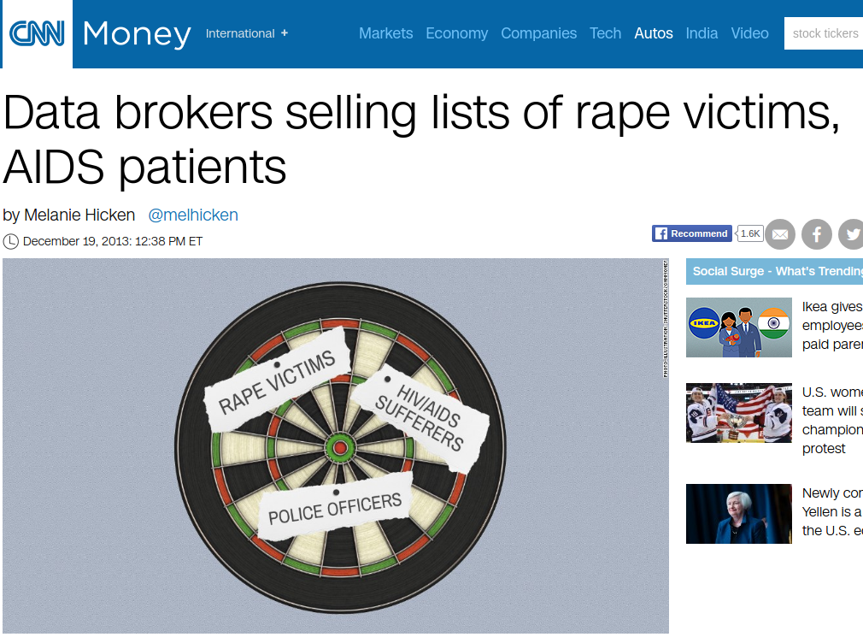
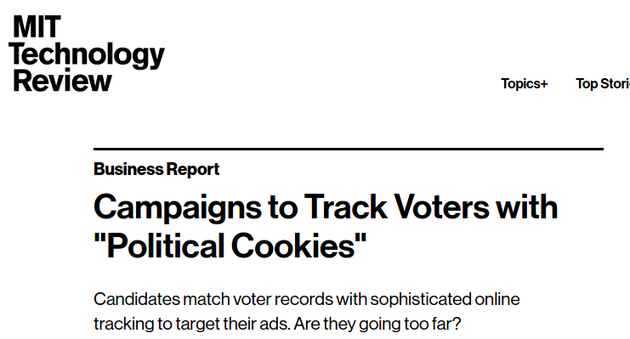
We’ve
lost control
over our data

Slide 16



@ work
Device vulnerabilities
Secrets and interests of each employee
Company’s activities and plans

Slide 17



ATTACK WORKFLOW
1. Attackers use employee’s data to prepare e-mail based on her interests (e.g., recent purchases or trips);
2. The e-mail contains a link to a malware; Leveraging social engineering techniques, the employee is induced to click the link;
3. The malware is built based on employee’s device vulnerabilities, and automatically infects the device and corporate network.

Slide 18


Slide 19

New story – How to deal with this?
Can the network help?

